Slide 1
Mock-Ups for VineCache

Slide 2
Mobile

Slide 3

Boot Screen

Slide 4
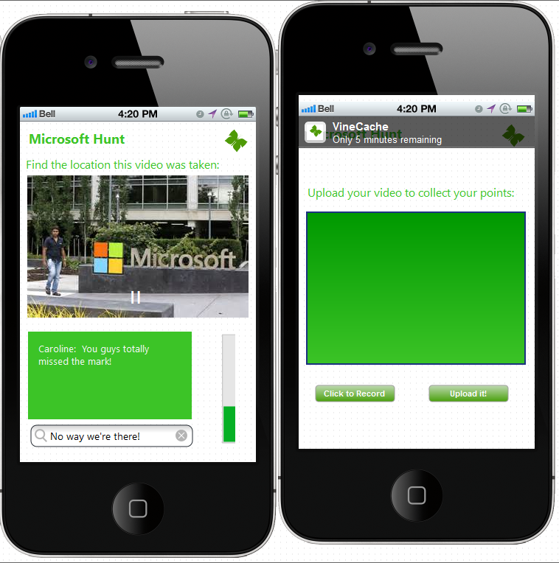
Notifications can be sent out by the admin
Hot/Cold
Indicator

Slide 5
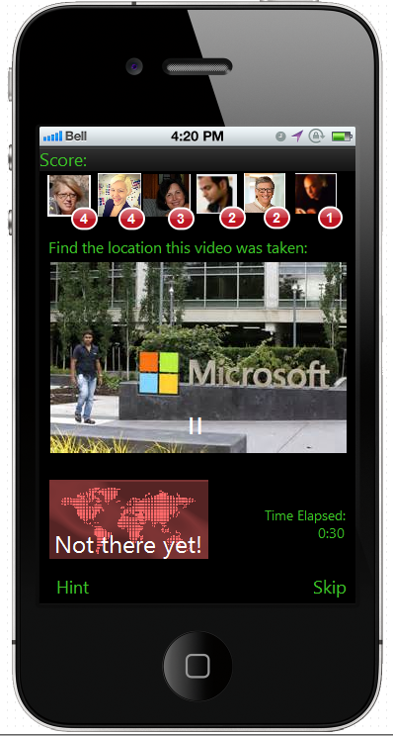
Hunting for a VineCache
Change leaderboard to be swipe-in from left
Change to match green/white theme of start screen and make this less “busy”
This feels out-of-place. Need better indicator for “you’re there”. Originally was thinking this would become the “hint” window, but maybe that should be swipe in from right?
Buttons could be overlays more like SnapChat

Slide 6
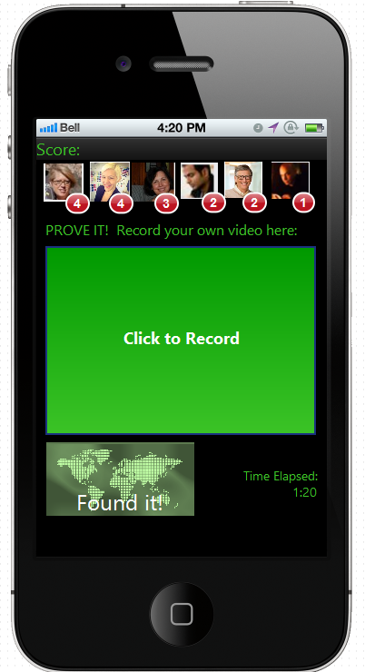
Found it! Record your own
Leaderboard swipe-in from left
Sort of ugly still. Need to think about how state change is presented to allow team to record their own

Slide 7
Web App

Slide 8
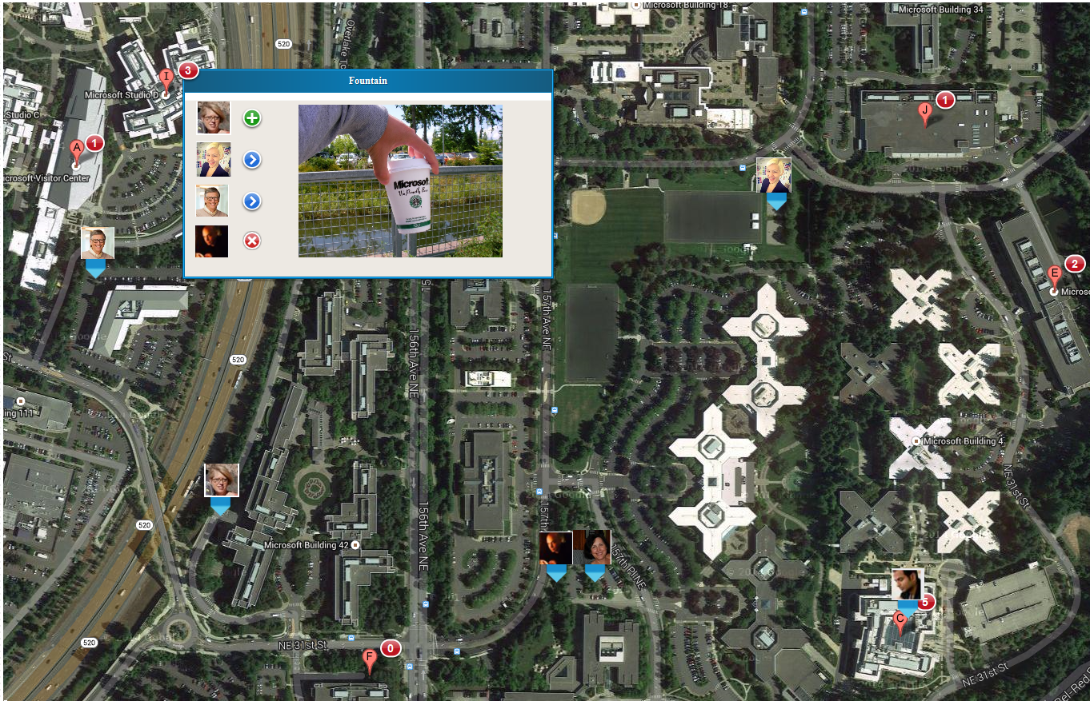
Add color theme/logos to header
Global Nav to switch between map, leaderboard, and videos
Just show whose found/skipped each site. Click through to video page to play the videos
Click to message a person? FB Messenger

Slide 9
Game Control Page
Need to think through:
Start and End of Event. (Call everyone back.)
Event Histories?
Leaderboard Page
Need to think through:
See status for each team.
Which sites have they visited, skipped, which is next up
Show their videos

Slide 10
Architecture

Slide 11
Mobile
Looked at Xamarian, CodeName One, and Elastic to cross-compile single code to all mobile platforms.
Each had unique draw-backs
Current plan is to code each in it’s own tool set independantly

Slide 12
Back-end
Data-store
Parse.com for data-store
socket.io for real-time chat and notifications
Identity – Facebook
Gives us an easy auth story and cool people pix
Longer term allows viral growth by posting to FB feeds

Slide 13
Web App
Requirejs, Fabricjs, knockout, socket.io, TypeScript, goog maps
Node.js and Express hosted on AWS Elastic Beanstalk
(Another way to “get started” could be yeoman.io using a knockout generator.)

